Slide 1

Type System & Generics
ThePhoto by PhotoAuthor is licensed under CCYYSA.

Slide 2
Scala Type System
What is the Type System?
The Type System in Scala helps define how different types are used in the language. It ensures that variables, functions, and collections use the correct types and that type-related errors are caught during compilation.
Type Inference
Scala has Type Inference, which means the compiler can often automatically figure out the type of a variable without you having to explicitly declare it.
Basic Types
Some basic types in Scala:
Int: Represents whole numbers.
String: Represents sequences of characters.
Boolean: Represents true or false.

Slide 3
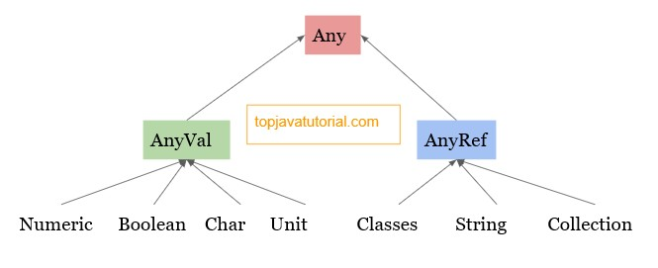
Type Hierarchy

Slide 4
Generics in Scala
Generics in Scala allow you to write reusable and type-safe code by using type parameters instead of hardcoding specific types.Flexibility Work with different types without rewriting code.
It lets you define classes, traits, methods, and functions that can operate on any data type.

Slide 5
Generic Class
class Box[T](private var item: T) { def setItem(newItem: T): Unit = item = newItem def getItem: T = item } object FruitBoxApp { def main(args: Array[String]): Unit = { val appleBox = new Box(5) println(appleBox.getItem) appleBox.setItem(10) println( appleBox.getItem) //appleBox.setItem("banana) //println( appleBox.getItem) val OrangeBox = new Box("Big Orange") println(OrangeBox.getItem) OrangeBox.setItem("Sweet Orange") println(OrangeBox.getItem) } }

Slide 6
Generic Method
def getLength[T](collection: List[T]): Int = { collection.length } object CollectionApp { def main(args: Array[String]): Unit = { println(getLength(List(1, 2, 3))) // Works with Int list println(getLength(List("jaya", "dhara", "manu","saba"))) // Works with String list } }

Slide 7
Covariant (+T):
A covariant type means that if A is a subtype of B, then Container[A] is a subtype of Container[B]. It preserves the subtype relationship.
Contravariant (-T):
A contravariant type means that if A is a subtype of B, then Container[B] is a subtype of Container[A]. It reverses the subtype relationship.
Type Bounds
You can restrict the type parameters using bounds
<: String(upper bound)
>:String/AnyRef(lower bound)

